Slide 1
World Breastfeeding Week (#WBW2020)
1 - 7 AUGUST 2020
coordinated by the World Alliance for Breastfeeding Action (WABA)

Slide 2
INTRODUCTION
The World Alliance for Breastfeeding Action (WABA) was formed on 14 February, 1991. WABA is a global network of individuals and organisations dedicated to the protection, promotion and support breastfeeding worldwide.
WABA coordinates the global World Breastfeeding Week (WBW) campaign that aims to inform, anchor, engage and galvanise action on breastfeeding and related issues.
Since 2016, we have aligned our WBW campaign to United Nation’s Sustainable Development Goals (SDGs). We call this the WBW-SDGs Campaign.

Slide 3
WBW-SDGs CAMPAIGN
WABA clustered the UN SDGs into 4 Thematic Areas that relate to each other and to breastfeeding. The 4 Thematic Areas will be celebrated in cycles until 2029.
2030 will be about taking stock of our progress, overcoming challenges and planning for work beyond the SDGs.
WBW2016 made links between each SDG and breastfeeding. WBW2017 emphasised the importance of working together across all the SDGs. WBW2018 cemented breastfeeding as the foundation of life. WBW2019 focused on empowering parents to enable breastfeeding.
World Breastfeeding Week 2020 (#WBW2020) highlights the links between breastfeeding and planetary health.

Slide 4
#WBW2020
The interconnected nature of people and the planet requires that we must find sustainable solutions that benefit both. We can reduce our carbon and ecological footprints starting with how we feed our babies.
Breastfeeding is one of the best investments in saving infant lives and improving the health, social and economic development of individuals and nations. Protection, promotion and support of breastfeeding are all important strategies and we have to collaborate with actors within and beyond the breastfeeding movement.

Slide 6
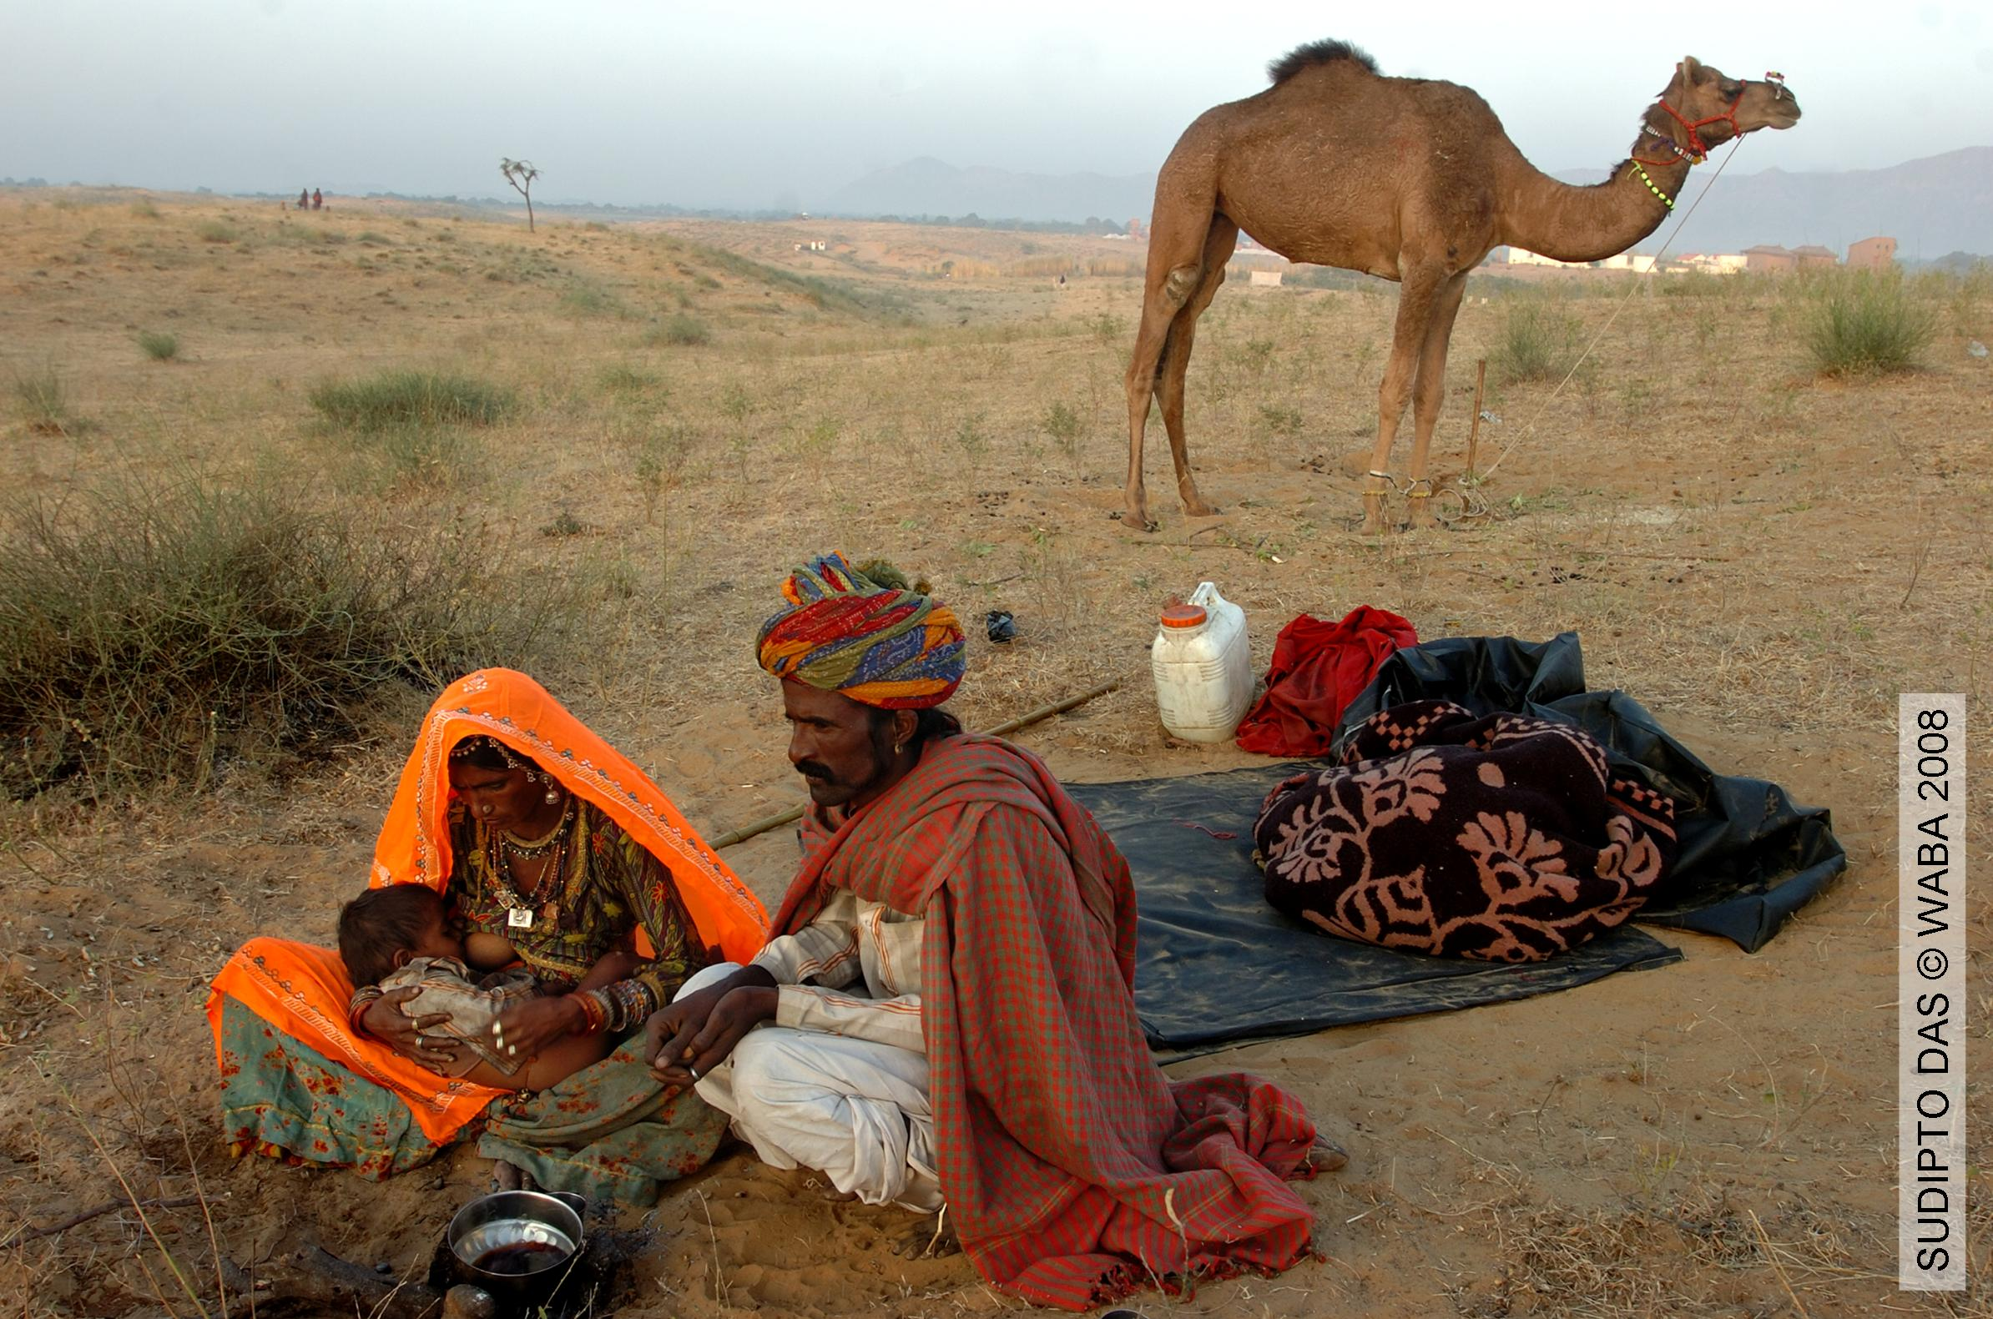
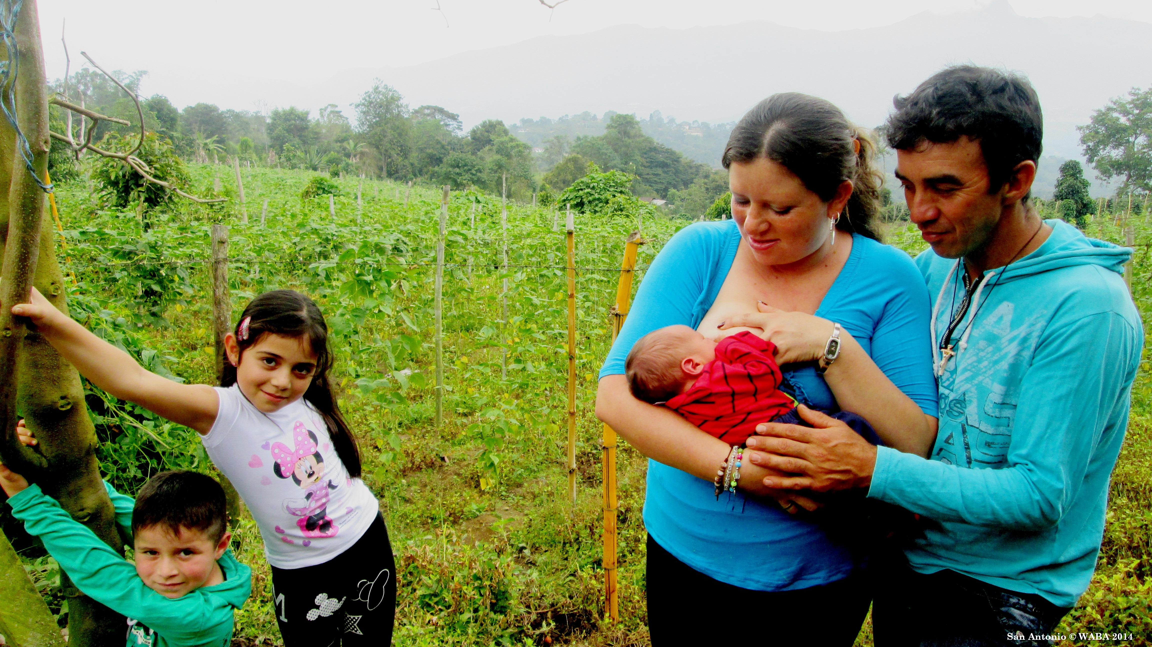
Climate change and environmental degradation are some of the most urgent challenges facing our world today.
Our food production systems and consumption patterns are significant contributors to climate change and environmental degradation

Slide 7
Depletion & destruction of natural resources and an increase in the emission of major GHG are at their highest levels for at least the past 800,000 years.
Although there have been many advances in global health in the past few decades, there are several emerging challenges for example natural disasters, infectious disease outbreaks such as the ongoing COVID-19 pandemic as well as a lack of adequate health systems.
Breastmilk is the first food that we consume and is a critical part of a sustainable food system. On the other hand, feeding with breastmilk substitutes (BMS) contributes to the problem and is a growing phenomenon.

Slide 8
Scaling up optimal breastfeeding could prevent more than 823 000 child & 20 000 maternal deaths each year. Not breastfeeding is associated with lower intelligence & results in economic losses of about $302 billion annually.
Only about 40% of all babies born annually are exclusively breastfed until 6 months & 45% continue any breastfeeding for up to 2 years. Often, there is a lack of support to breastfeed, whether in the health system, workplace or community.

Slide 9
Direct breastfeeding & hand expression of breastmilk are efficient in terms of reducing waste & saving energy & other resources.
Dairy farming typically releases substantial amounts of methane & other GHG. Additionally, the manufacturing, packaging, distribution & preparation processes of BMS requires energy & water. All of this impacts the environment & feeding one million babies with formula for two years requires, on average, approximately 150 million cans of formula.

Slide 10
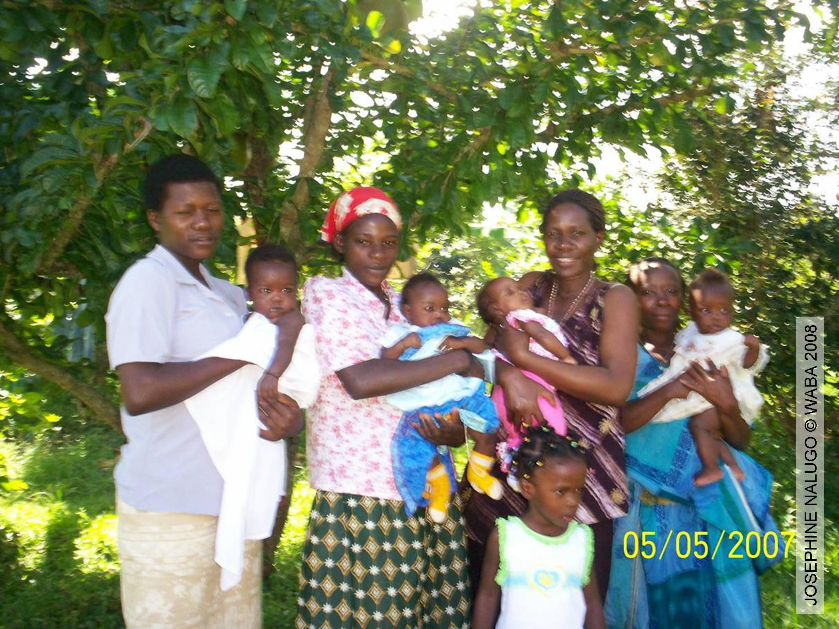
Sustainable development meets the needs of the current generation without compromising future generations.
We must intensify the conversations, call for more robust research, and engage all relevant sectors to take action.

Slide 11
Align national & international policies and guidance on breastfeeding & IYCF with the SDG agenda & other environment/climate initiatives.
Ensure that a public health perspective is taken to strengthen BFHI & breastfeeding counselling among the general population including during emergencies.
Raise awareness among decision-makers to recognise the contribution of breastfeeding to food security & environmental sustainability.
Advocate for policies aimed at reducing carbon emissions from the BMS industry.
Ensure that the International Code of Marketing of Breastmilk Substitutes & relevant WHA resolutions are fully implemented & monitored.
Enact paid family leave & workplace breastfeeding policies based on the ILO Maternity Protection Convention C183 as the minimum standard.
SDGs as a framework
for planetary health

Slide 12
Advocate for increased financing, monitoring & implementation of better policies & interventions to provide families the support for breastfeeding that they need, especially breastfeeding counselling.
Inform communities about the impact of formula feeding on the environment using a variety of communication techniques and influencers.
Sensitise journalists and the media to stimulate public debate on the links between breastfeeding & the environment/climate change.
Allocate resources for additional research on the climate/environmental impact of BMS.
Collect systematic data on the impact of different IYCF policies & programmes in emergency situations.
Societal support

Slide 13
Advocate for all women/parents with young children to have access to skilled breastfeeding counselling from health facilities & communities.
Implement the revised BFHI 2018 guidelines in all health facilities including private hospitals.
Allocate resources for community groups to be able to provide basic breastfeeding counselling & other forms of support close to women/parents.
Breastfeeding counselling is essential

Slide 14
Advocate for ongoing antenatal & postnatal breastfeeding counselling contact to sustain optimal breastfeeding.
Create a warm chain of support for breastfeeding by identifying key actors & their roles in the first 1000 days and linking them to each other.
Engage fathers/partners & family support to share domestic responsibilities & care for the breastfeeding dyad.
Join a mother/parent support group & share experiences with others in the community to normalise breastfeeding.
Develop creative ideas for virtual & online activities to engage target audiences in #WBW 2020.
Ongoing support across the first 1000 days

Slide 15
Invest in consistent training programmes for different levels of health professionals, lactation consultants, community health workers & lay/peer supporters.
Advocate for placement of appropriately-trained & skilled staff at various levels: peer supporters, health professionals, lactation consultants and resource persons.
Promote scaling up of existing breastfeeding training tools and programmes including online, digital & e-learning methods, as well as face-to-face clinical & other practical teaching.
Engage school children, students, youth & social media influencers to spread awareness of the importance of breastfeeding for planetary health.
Building knowledge and skills at all levels

Slide 16
Promote the use of evidence-based international IYCF guidelines to develop national action plans & communication messages.
Ensure that breastfeeding protection, promotion & support is specifically included in national emergency-preparedness & response plans.
Inform all health workers, community groups & the public about the importance of breastfeeding in national- & community preparedness plans.
Reinforce support for breastfeeding families that targets all members of the family & the community by developing appropriate & consistent communication messages.
Emphasise hand expression of breastmilk, appropriate use of breastpumps where safe, correct breastmilk storage & preparation, cup feeding, techniques to maintain breastmilk supply, relactation & wet nursing.
Ensure that donor human milk is available for babies who need it through human milk banks or other appropriate community initiatives.
Leaving no one behind

Slide 17
A warm chain of support creates an enabling environment that empowers all women/parents
to breastfeed optimally. Together, we can achieve a win-win situation for humanity and the planet.

Slide 18
5 WAYS TO CELEBRATE #WBW2020
Share on our social media platforms:
your breastfeeding experiences and support needed during the COVID-19 pandemic
your thoughts about the links between breastfeeding and environment/climate change
Pledge & Report your #WBW2020 activities (physical and/or virtual)
Tune in to our #WBW2020 podcasts and send us your questions/comments
Participate in the #WBW2020 Ask Me Anything (AMA)
Follow the WBW website and social media platforms (Facebook, Twitter & Instagram) for more activity ideas and updates
Tell us how you will engage to celebrate #WBW2020!

